Slide 1

ELIMU YETU COALITION
Newsletter report January – April 2026

Slide 2
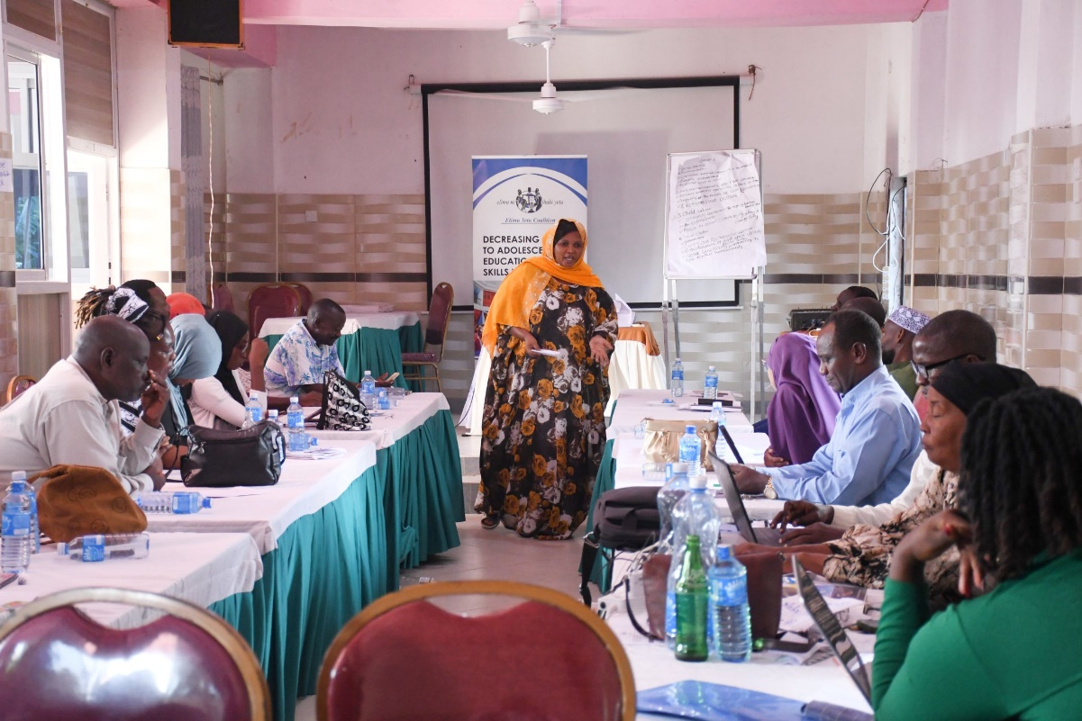



Highlights
This newsletter highlights key engagements, policy dialogues, workshops, and advocacy initiatives undertaken by Elimu Yetu Coalition (EYC) between January and April 2026
The activities focused on strengthening education financing, promoting inclusive and equitable education, supporting refugee education, and advancing teacher development and wellbeing.

Slide 3
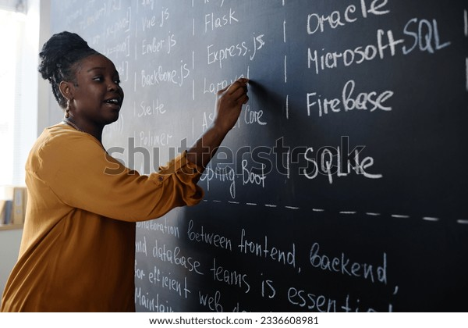


Slide 4
STRENGTHENING ACCOUNTABILITY FOR GENDER EQUALITY
IN EDUCATION
D
DEVELOPMENT PARTNERS ROUNDTABLE ON EDUCATION FINANCING
01
D
LAUNCH OF TH FOUNDATIONAL LITERACY AND NUMERACY ASSESSMENT (FLANA) 2025 REPORT
02
D
ENGAGEMENT MEETING WITH REFUGEE COMMUNITY TEACHERS OF PRACTICE IN DADAAB
03
04

Slide 5

“ STRENGTHENING ACCOUNTABILITY FOR GENDER EQUALITY
IN EDUCATION ’’
On 22 January 2026, the UNESCO Regional Office for Eastern Africa convened a meeting on accountability for gender equality in education, bringing together key stakeholders, including the Elimu Yetu Coalition. The meeting focused on reviewing findings from the AI survey and finalizing the AI scan, with the aim of identifying critical gaps and opportunities for strengthening gender-responsive education systems.
Participants also reflected on key lessons from the Wajir sub-national workshop, where discussions underscored the need for more effective planning, enhanced coordination at the local level, and stronger stakeholder engagement. Looking ahead, UNESCO reaffirmed its commitment to working closely with partners during the next phase of fieldwork across the remaining counties. The organization also emphasized that the safety and well-being of both researchers and participants will remain a central priority throughout all future activities

Slide 6
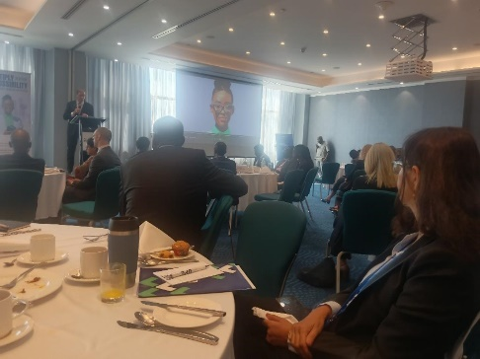
“ DEVELOPMENT PARTNERS ROUNDTABLE ON EDUCATION FINANCING ”
On 26 January 2026, Elimu Yetu Coalition participated in a high-level Development Partners Roundtable on Education Financing convened by the Global Partnership for Education (GPE). The forum focused on sustainable education financing and the GPE 5th Replenishment process. Stakeholders emphasized the need to strengthen partnerships, advocate for increased investment in education despite shrinking global resources, prioritize foundational learning, and align partner support with the objectives of GPE 2030.

Slide 7
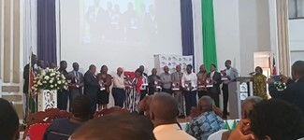
“ LAUNCH OF THE FOUNDATIONAL LITERACY AND NUMERACY ASSESSMENT (FLANA) 2025 REPORT ”
Elimu Yetu Coalition also participated in the launch of the FLANA 2025 Report convened by Usawa Agenda. The report underscored the importance of ensuring all learners at the foundational level acquire literacy and numeracy skills. It further highlighted the urgent need to address high teacher-learner ratios that continue to affect learning outcomes in many schools.
Elimu Yetu Coalition (EYC) participated in the launch of the Foundational Literacy and Numeracy Assessment (FLANA) 2025 Report, convened by Usawa Agenda. The event marked a significant step toward strengthening Kenya’s national systems for measuring foundational learning and ensuring that all children acquire essential literacy and numeracy skills.
Key insights from the report were the need to ensure that all learners at the foundational level are able to read and write effectively. Additionally, the findings pointed to the urgent need to address high teacher-learner ratios in many schools, which continue to hinder quality learning.

Slide 8
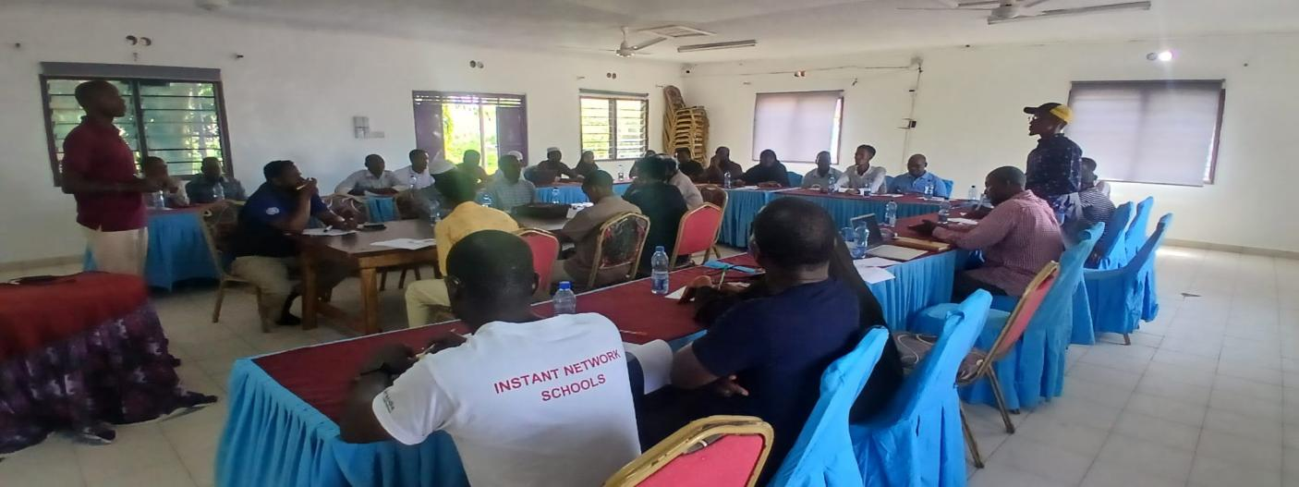
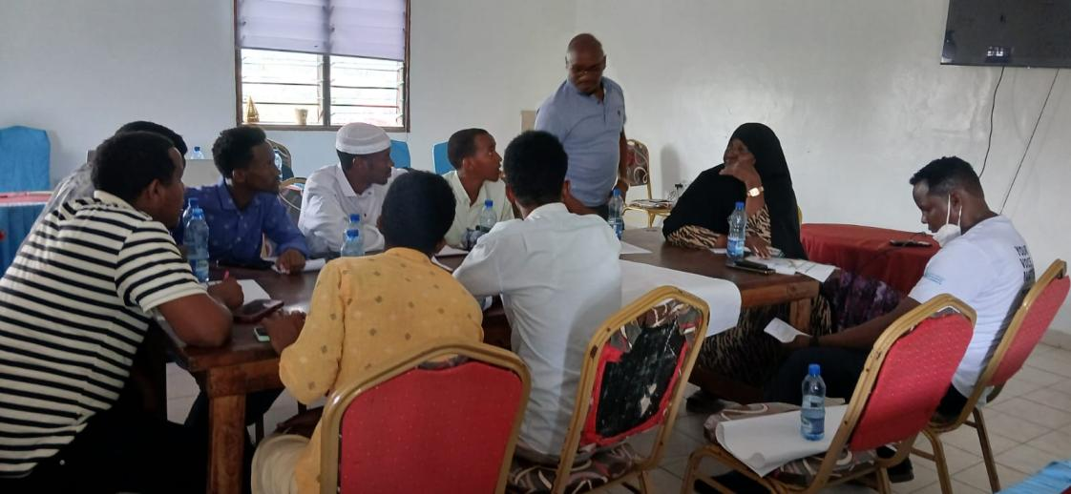
“ ENGAGEMENT MEETING WITH REFUGEE COMMUNITY TEACHERS OF PRACTICE IN DADAAB ”
Between 31 January and 1 February 2026, ministry officials, UNHCR representatives, and members of the Refugee Community Teachers of Practice (RCToP) met in Dadaab to develop a formal memorandum addressing challenges faced by refugee teachers. The meeting strengthened participants’ understanding of policy development and advocacy processes while laying the foundation for improved professional recognition and support for refugee teachers

Slide 9
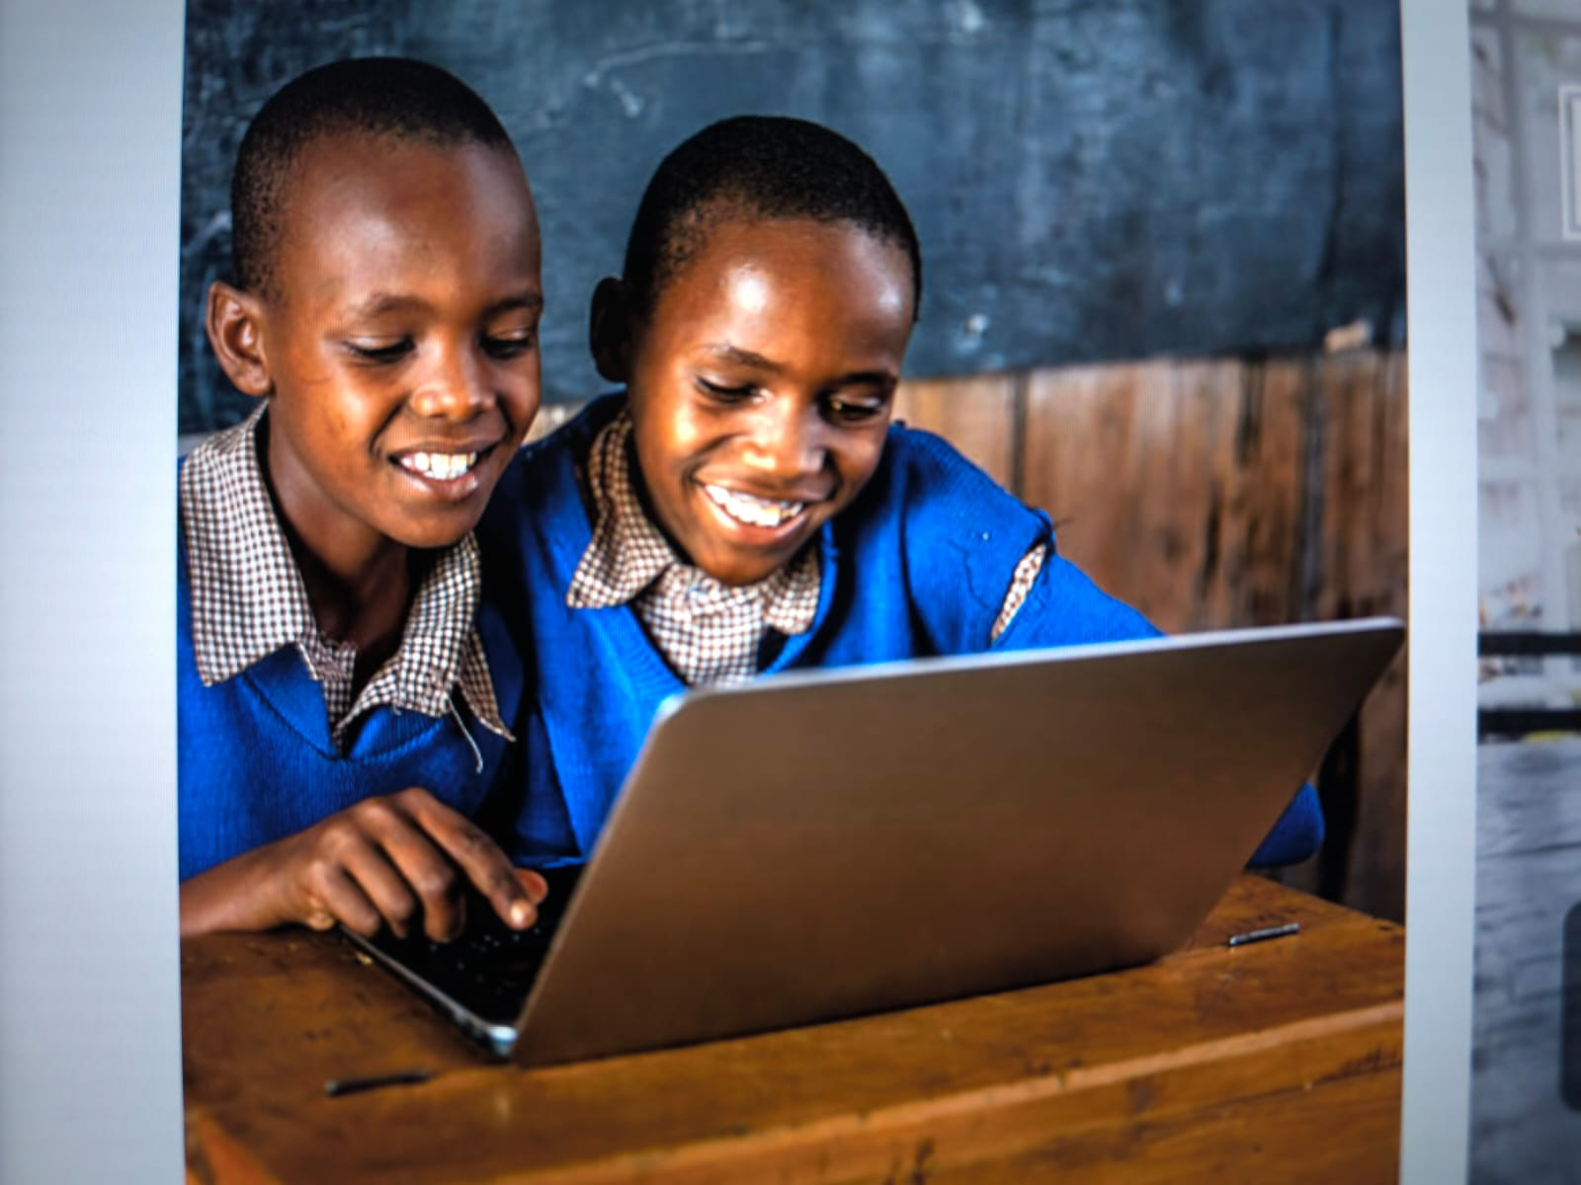
FEBRUARY 2026

Slide 10
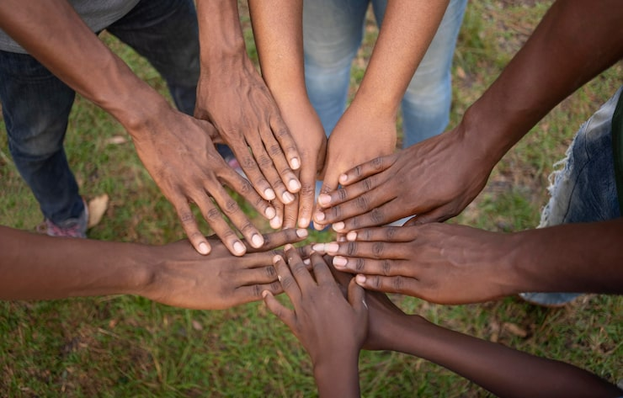

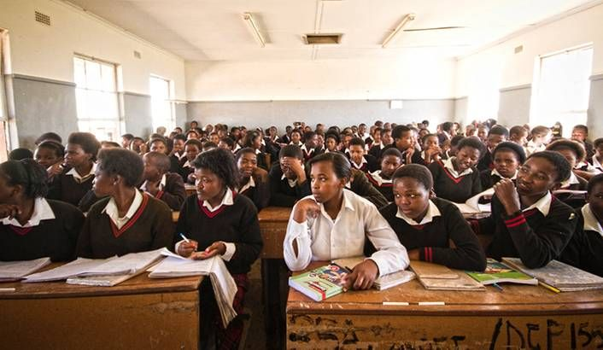
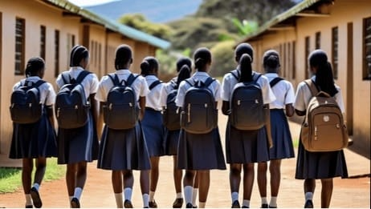
CONTENTS
TURKANA COUNTY EDUCATION BOARD AND PARTNERS JOINT WORKSHOP.
INAUGURAL ELIMU YETU COALITION BOARD MEETING AND LEADERSHIP TRANSITION
ADVANCING TEACHER EDUCATION REFORM IN KENYA

Slide 11
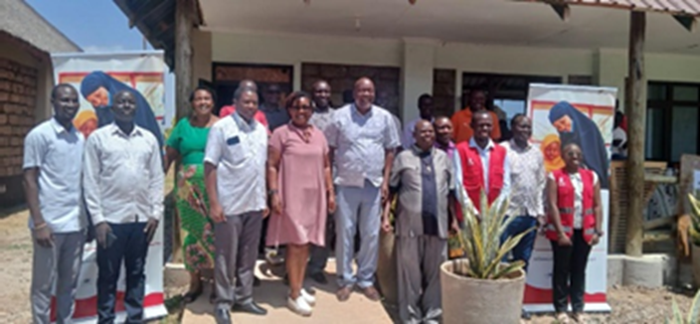
“TURKANA COUNTY EDUCATION BOARD AND PARTNERS JOINT WORKSHOP.”
From 3rd to 5th February 2026, Elimu Yetu Coalition attended a joint workshop of the Turkana County Education Board (CEB) and its partners which was convened to strengthen inclusive education governance and coordination. The meeting focused on enhancing the CEB’s role in supporting inclusive education, deepening understanding of refugee education integration frameworks, and reviewing progress while identifying gaps in service delivery within refugee-hosting contexts. The workshop further highlighted the importance of data-driven approaches to inform policy and decision-making, especially in addressing the needs of both host and refugee communities.

Slide 12

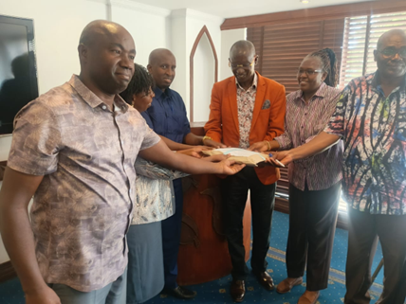
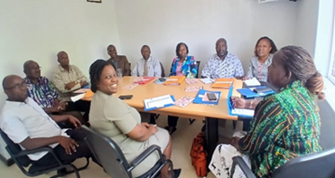
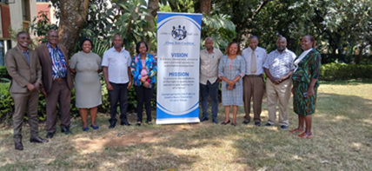
“INAUGURAL ELIMU YETU COALITION BOARD MEETING AND LEADERSHIP TRANSITION”
On 5–6 February 2026, Elimu Yetu Coalition convened its inaugural Board Meeting, marking the official transition between outgoing and incoming Trustees.
The transition reinforced continuity in governance and renewed commitment toward accountability, strategic leadership, and effective implementation of the coalition’s mission.

Slide 13

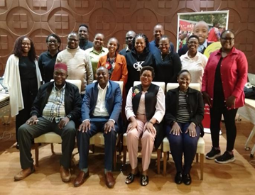
“ ADVANCING TEACHER EDUCATION REFORM IN KENYA ”
From 9–13 February 2026, the Ministry of Education, in partnership with Save the Children, convened a workshop to review the draft Teacher Education and Training Policy.
Key recommendations included establishing a dedicated in-service teacher training institution to strengthen continuous professional development and improve teacher preparedness.

Slide 14

MARCH 2026
PEER-TO-PEER LEARNING ON GLOBAL CAMPAIGN FOR EDUCATION REPLENISHMENT
DIGITAL LEARNING AND POPULATION EDUCATION DIALOGUE
JOINT TECHNICAL MISSION FOR SEEQIP AND KPEEL
KILIFI COUNTY DIALOGUE FORUM ON EDUCATION

Slide 15

PEER-TO-PEER LEARNING ON GLOBAL CAMPAIGN FOR EDUCATION REPLENISHMENT
On 12 March 2026, EYC participated in a peer-learning session organized by the Global Campaign for Education to share Kenya’s experience during the 2021 GPE replenishment process. EYC highlighted the important role played by civil society in mobilizing support, strengthening advocacy, and promoting education financing.

Slide 16
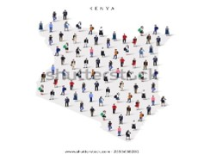
DIGITAL LEARNING AND POPULATION EDUCATION DIALOGUE
Elimu Yetu Coalition had been invited to give a perspective along the line; ‘Educating a Growing Nation: Aligning Population Dynamics, Education System and Sustainable Development.’
During a high-level meeting on Population Education for Sustainable Development, stakeholders discussed the impact of Kenya’s demographic trends on education and national development. The forum emphasized the need for investment in CBC infrastructure, improved cross-sector coordination, and alignment between education and labour market demands.

Slide 17
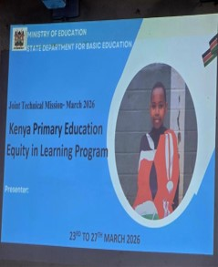
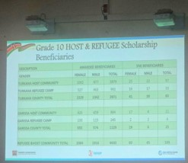
JOINT TECHNICAL MISSION FOR SEEQIP AND KPEEL
Between 23–26 March 2026, EYC participated in a joint technical mission for the Secondary Education Equity and Quality Improvement Project (SEEQIP) and Kenya Primary Education Equity in Learning (KPEEL) programmes supported by the World Bank.
The mission reviewed progress in improving education equity and quality, while also recommending infrastructure improvements, expansion of virtual laboratories, enhanced CBC awareness, and stronger support for vulnerable learners.

Slide 18
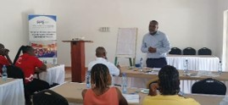
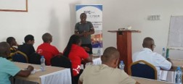
KILIFI COUNTY DIALOGUE FORUM ON EDUCATION
Elimu Yetu Coalition (EYC) convened a County Dialogue Forum on Education in Kilifi County on 27th March 2026, bringing together government officials, civil society organizations, and education stakeholders to discuss barriers affecting access, retention, and transition in education. Key issues raised included low transition rates, long distances to schools, harmful cultural practices, learner dropout, and weak parental involvement in education matters.
The forum concluded with a renewed commitment to strengthen advocacy, support vulnerable learners, and promote inclusive and equitable education for all children in the county.
CEC Kilifi representative Mativo Jonathan addressing participants
EYC National Coordinator Joseph Wasikhongo

Slide 19
APRIL 2026
GARISSA COUNTY BASED FORUM
LAUNCH OF EDUCATION FINANCE CHARTER
GARISSA COUNTY EDUCATION BOARD AND PARTNERS JOINT WORKSHOP
GLOBAL ACTION WEEK OF EDUCATION 2026
TEACHER WELL BEING VALIDATION AND LEARNING WORKSHOP

Slide 20
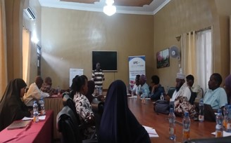
GARISSA COUNTY BASED FORUM
On 9–10 April 2026, EYC convened education dialogue forums in Garissa County involving government officials, teachers, civil society organizations, and refugee representatives. Discussions focused on teacher shortages, overcrowded classrooms, low enrolment, inadequate infrastructure, and recognition of refugee teachers. Stakeholders committed to strengthening collaboration to promote inclusive and equitable education.

Slide 21
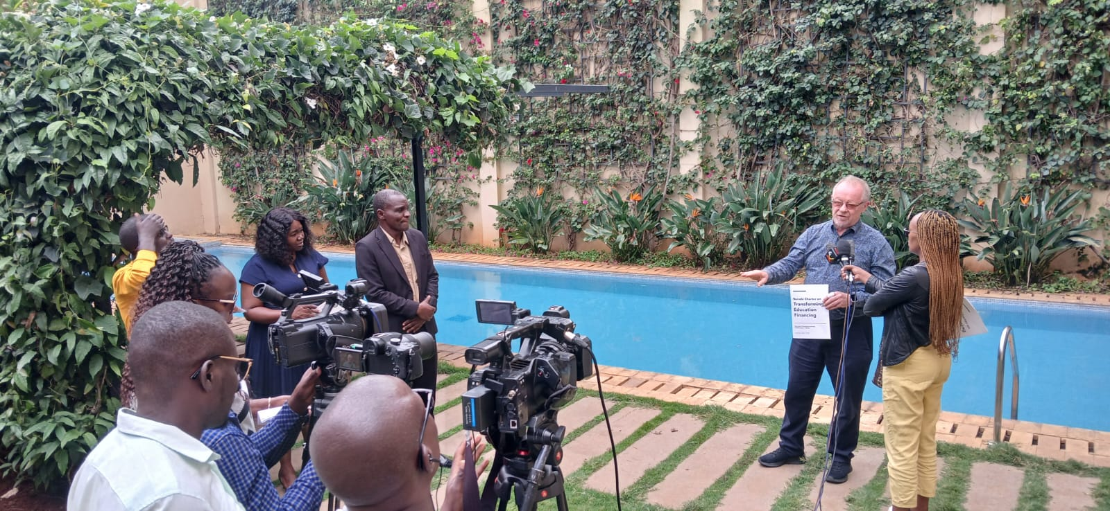
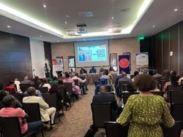
LAUNCH OF EDUCATION FINANCE CHARTER
From 20–24 April 2026, civil society organizations from Eastern, Southern, West, and Central Africa convened in Nairobi for the Global Action Week for Education meeting under the Education Financing Learning Collaborative. A key outcome was the launch of the Education Finance Charter, which calls for increased education funding, stronger accountability mechanisms, and equitable access to quality education across Africa.

Slide 22
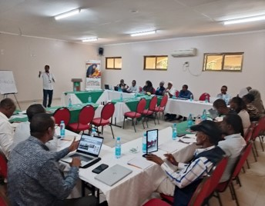
GARISSA COUNTY EDUCATION BOARD AND PARTNERS JOINT WORKSHOP
On 21st to 23rd April the Garissa County Education Board (CEB) and Partners held a joint workshop aimed at strengthening the role of the CEB in inclusive education governance, enhance understanding of refugee education integration frameworks, review progress and identify service delivery gaps in refugee-hosting contexts, and promote evidence-based advocacy for teacher deployment, recognition, and wellbeing.
Some of the recommendations highlighted were as follows;
Strengthen the role of CEB in providing advisory and oversight functions on refugee education.
Fast-track the registration of all refugee camp schools as public/community schools under the Ministry of Education.

Slide 23
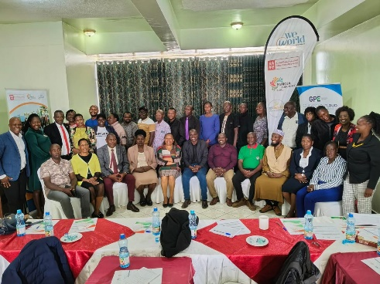
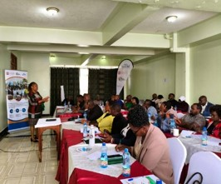
GLOBAL ACTION WEEK OF EDUCATION 2026
On 22 April 2026, EYC convened the GAWE 2026 Forum supported by WeWorld Kenya. Discussions centered on education financing, equity, accountability, and system strengthening.
Stakeholders emphasized the importance of timely funding, effective data use, and improved coordination among government, civil society, and development partners.

Slide 24
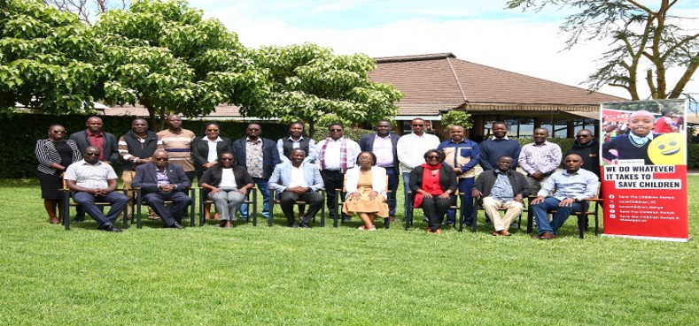
TEACHER WELLBEING VALIDATION AND LEARNING WORKSHOP
The TeachWell Project held a validation workshop in Naivasha to review findings on teacher well-being in refugee and refugee-hosting communities in Garissa and Turkana counties. The workshop brought together consortium partners, including Elimu Yetu Coalition, and government stakeholders from the Ministry of Education and Teachers Service Commission. Findings highlighted key challenges such as poor working conditions, limited policy recognition, heavy workloads, inadequate psychosocial support, and gaps in safety and inclusive education. The Ministry of Education validated the findings and emphasized the need for policy and system reforms.

Slide 25

Way Forward for EYC
Elimu Yetu Coalition will continue strengthening advocacy efforts, supporting inclusive and equitable education systems, and promoting evidence-based policy engagement at both national and county levels. The Coalition will also continue collaborating with partners to improve teacher wellbeing, refugee education, education financing, and foundational learning outcomes.

Slide 26

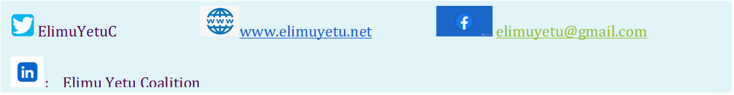
CONTACT
HILL SIDE APARTMENTS, 2ND FLR,
RAGATI ROAD, OFF HAILLE SELLASIE AVENUE,
P.O. BOX 24621-00100
NAIROBI, KENYA.
CELL: +254-715 242 644; +254 0787 146120
Toll-free No; 0800 720 940

